Slide 1
Today’s Outline
Agents and Environments
Good Behavior: Rationality, Omniscience & Autonomy
PEAS (Performance measure, Environment, Actuators, Sensors)
Environment types
Agent types
1

Slide 2


Slide 3
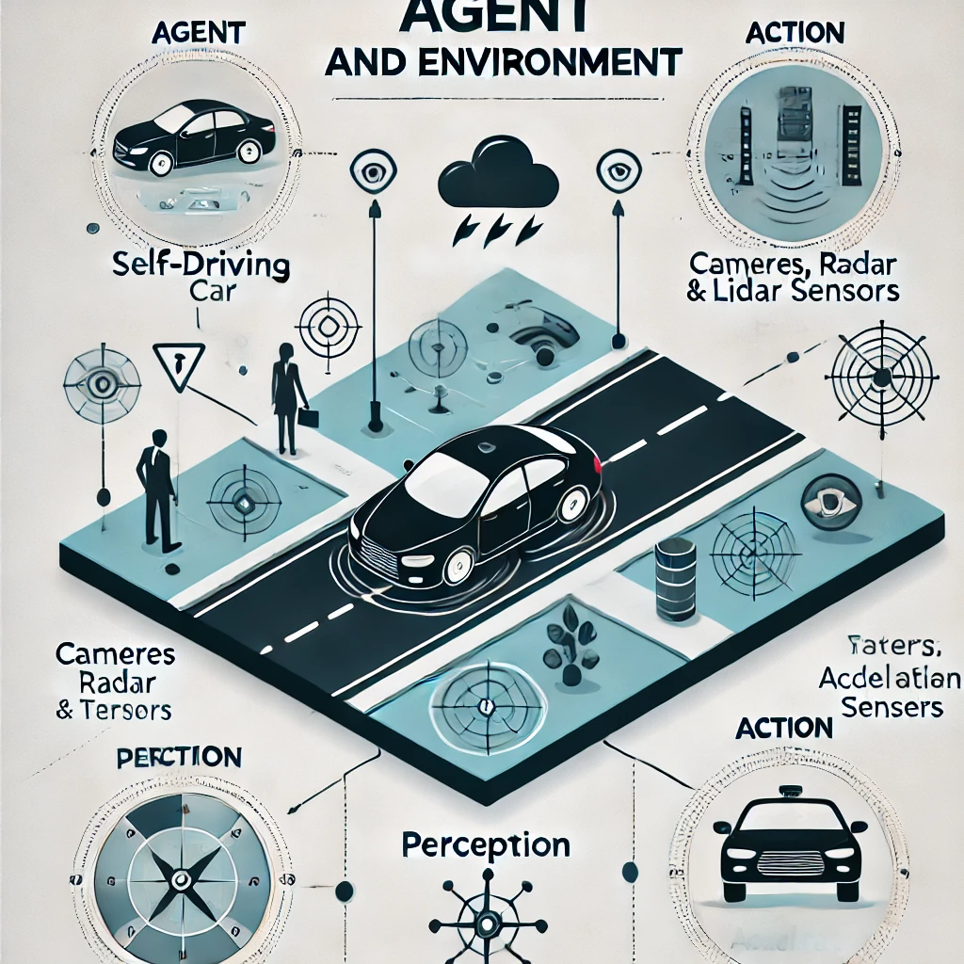

Slide 4
AI Entities
When creating artificial intelligence, the purpose is to produce entities that can operate independently of human direction.
– An entity may act on a human’s behalf though
These entities need to have the following properties:
– Autonomy = needs no direct involvement to perform duties.
– Responsive (reactivity) = must be able to perceive and react to its environment.
– proactivity = must exhibit goal-directed behavior.
– Sociability = interacts with humans and other agents.
Notes:
Proactive Calendar Management: The AI schedules meetings by considering your past availability, workload, and typical patterns. It might suggest blocking out focus time if it notices your schedule is becoming too crowded, or it could reschedule events based on priority without being told to do so.
Recommendation Systems: An e-commerce AI that doesn't just react to your searches but proactively suggests products based on your buying habits, future events (like upcoming holidays), or even what you may need next.

Slide 5
Agent Definition (2)
Agents = a software entity that exists in an environment and acts on that environment based on its perceptions and goals.
5

Slide 6
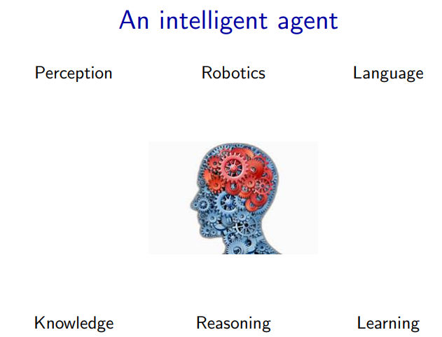
Agent Definition (3)
The starting point for the agent-based view is ourselves.
• As humans, we have to be able to perceive the world (computer vision), perform actions in it (robotics), and communicate with other agents.
• We also have knowledge about the world (from how to ride a bike to knowing the capital of France), and using this knowledge we can draw inferences and make decisions.
• Finally, we learn and adapt over time. Indeed machine learning has become the primary driver of many of the AI applications we see today
6

Slide 7
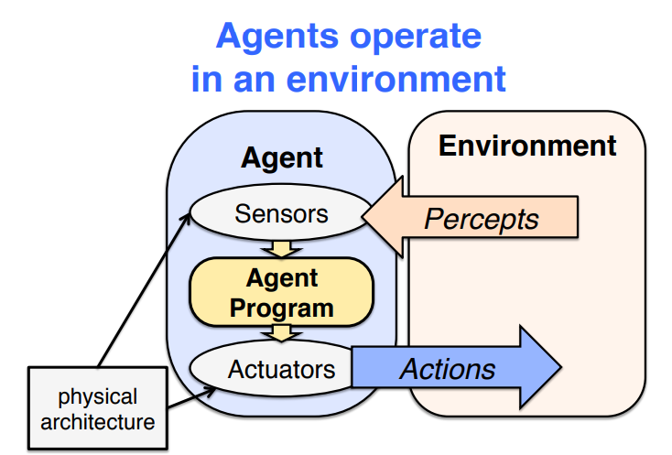

Slide 8
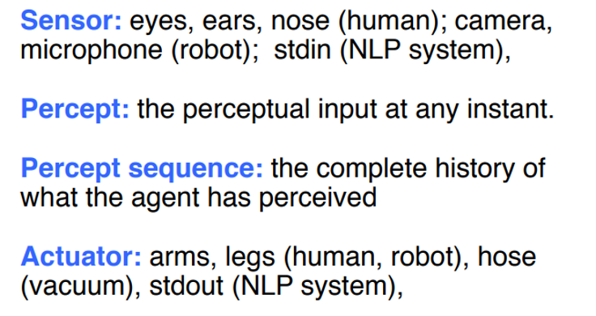
Agent Example
An agent perceives its environment via sensors and acts upon that environment through its Actuators

Slide 9
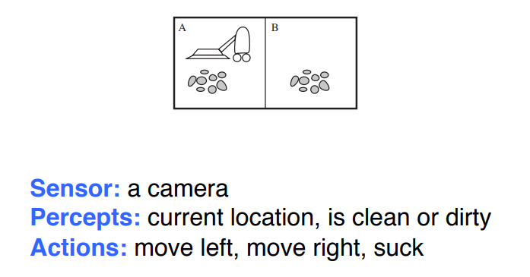
Example: The vacuum world

Slide 10
Example:
Agent: A self-driving car.
Environment: A road with traffic, pedestrians, and weather conditions.
Perception: The car's cameras, radar, and lidar sensors gather information about its surroundings.
Action: The car's steering, acceleration, and braking systems allow it to navigate the environment.

Slide 11
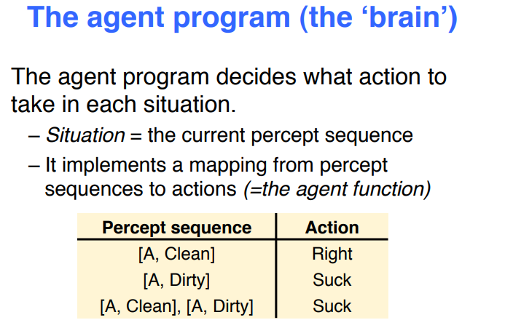

Slide 12
Perception
Perception is the result of the function
see: S → P
where
– P is a (non-empty) set of percepts (perceptual inputs).
Then, the action becomes:
action: P → A
which maps sequences of percepts to actions

Slide 13


Perception ability
Non-existent perceptual ability
Omniscient
MIN
MAX
| E | = 1
| E | = | S |
Where E: is the set of different perceived states.
Vision:
Color: Seeing the color "red" as opposed to "blue" is a distinct state.
Shape: Distinguishing a circle from a square represents two different states.
Hearing:
Pitch: Distinguishing a high-pitched sound from a low-pitched sound represents different states.
Volume: Perceiving a sound as loud or soft are separate states.

Slide 14
Perception ability
Non-existent perceptual ability
Omniscient
MIN
MAX
| E | = 1
| E | = | S |
Two different states s₁∈ S and s₂ ∈ S (with s₁ ≠ s₂) are
indistinguishable if see( s₁ ) = see( s₂ ).
s₁ and s₂ are indistinguishable if they are perceived the same way.
This means that someone with limited perception ability might not be able to tell the difference between certain states, even if they are objectively different.

Slide 15
Perceived States Examples
Agent: Self-driving car
Percept sequence: A red car is stopped at a red light.
Action: Stop the car.
States:
State 1: There is a red car in front.
State 2: There is no car in front.
State 3: The light is red.
State 4: The light is green.

Slide 16
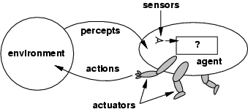
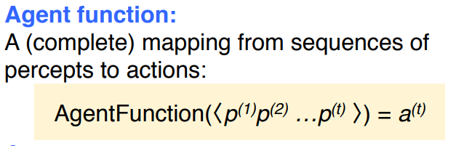
Agents and environments
The agent program is an implementation of f that runs on the physical architecture to produce f
agent = architecture + program
10

Slide 17
Example
the agent function might map: (Ideal World)
Percept 1: "There’s dust in the corner"
Percept 2: "The chair is in the way"
Percept 3: "The battery is low“
into a perfect action like:
Action: "Move around the chair, clean the dust in the corner, and return to the charging dock before the battery dies."
Agent Program (Real-world):
Sensors are imperfect; environment changes.
Approximates agent function using available data.
Practical challenges:
Detects dust but not as precisely.
Bumps into furniture occasionally.
Might return to the dock without finishing the cleaning if the battery is low.

Slide 18
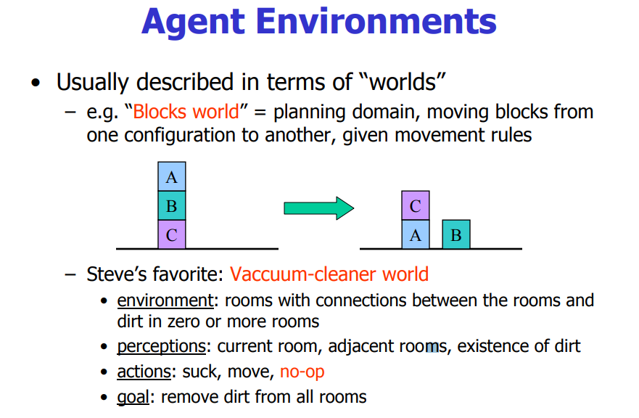

Slide 19
Rational agents
Rationality: What is rational at any given time depends on four things i.e.
Performance measure that defines success
Agents prior knowledge of environment
Actions that agent can perform
Agent’s percept sequence to date
Rational Agent: For each possible percept sequence, a rational agent should select an action that is expected to maximize its performance measure, given the evidence provided by the percept sequence and whatever built-in knowledge the agent has.

Slide 20
Rational agents
Imagine a self-driving car as a rational agent.
Performance measure: Safely reach the destination while minimizing travel time.
Prior knowledge: Traffic laws, road map, car's capabilities.
Possible actions: Accelerate, brake, change lanes, etc.
Percept sequence: Objects detected by sensors (other cars, pedestrians, traffic lights).
The car continuously perceives its surroundings, considers actions like changing lanes to overtake a slow car, and selects the action that aligns best with its goals, considering safety and efficiency.

Slide 21
Rationality vs Omniscience
Rational is different from omniscience
Percepts may not supply all relevant information
E.g., in card game, don’t know cards of others.
Rational is different from being perfect
Rationality maximizes expected outcome
while perfection maximizes actual outcome.

Slide 22
Specifying the Task Environments
Task Environments are essentially the problems to which rational agents are the solutions.
In designing an agent the first step must always be to specify the task environment as fully as possible a.k.a PEAS (Performance measure, Environment, Actuators, Sensors)
Example (Automated Taxi): Consider, e.g., the task of designing an automated taxi driver agent:
Performance measure: Safe, fast, legal, comfortable trip, maximize profits.
Environment: Roads, other traffic, pedestrians, customers.
Actuators: Steering wheel, accelerator, brake, signal, horn.
Sensors: Cameras, sonar, speedometer, GPS, odometer, engine sensors, keyboard.

Slide 23
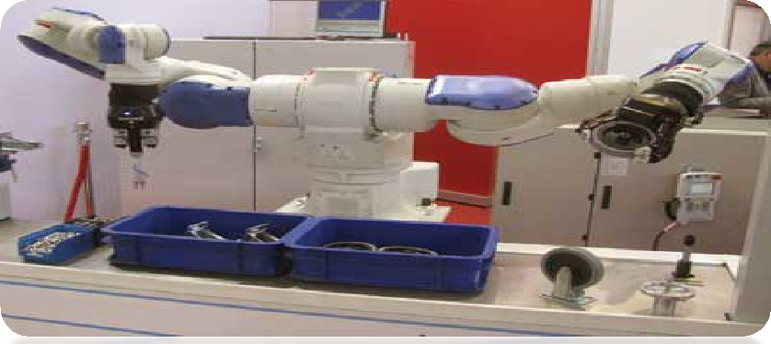
PEAS - Example # 02
Agent: Part-Picking Robot
Performance measure: Percentage of parts in correct bins
Environment: Conveyor belt with parts, bins
Actuators: Jointed arm and hand
Sensors: Camera, joint angle sensors

Slide 24
Autonomy in Agents
The autonomy of an agent is the extent to which its behaviour is determined by its own experience, rather than knowledge of designer.
Extremes
No autonomy – ignores environment/data
Complete autonomy – must act randomly/no program
Example: baby learning to crawl
Ideal: design agents to have some autonomy
Possibly become more autonomous with experience

Slide 25
Autonomy in Agents
Not completely determined by designer: The car doesn't blindly follow a pre-programmed route, but can adjust its speed, lane, and braking based on traffic conditions, obstacles, and other factors.
Not completely random: The car has clear goals (reach the destination safely) and operates within traffic laws and safety regulations.
Learns from experience: Over time, the car's algorithms can improve by learning from driving data and past scenarios.

Slide 26
Environment types
Fully observable vs. partially observable
Deterministic vs. stochastic
Episodic vs. sequential
Static vs. dynamic
Discrete vs. continuous
Single agent vs. multi-agent

Slide 27
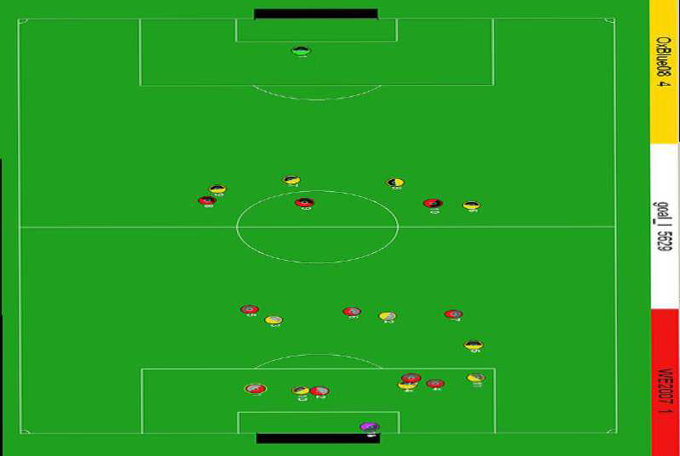
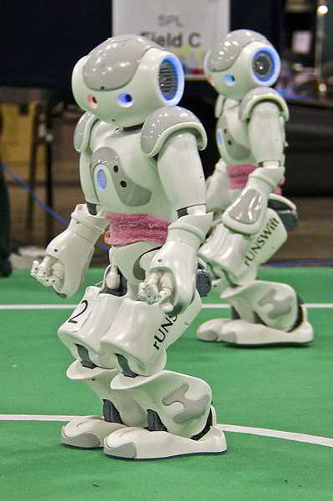
Fully observable vs. partially observable
Do the agent's sensors give it access to the complete state of the environment?
– For any given world state, are the values of all the variables known to the agent?
vs.

Slide 28

Examples
Poker Game (Partially)
Part Picking Robot (Fully)
19

Slide 29


Deterministic vs. stochastic
Is the next state of the environment completely determined by the current state and the agent’s action?
Is the transition model deterministic (unique successor state given current state and action) or stochastic (distribution over successor states given current state and action)?
Strategic: the environment is deterministic except for the actions of other agents
vs.

Slide 30
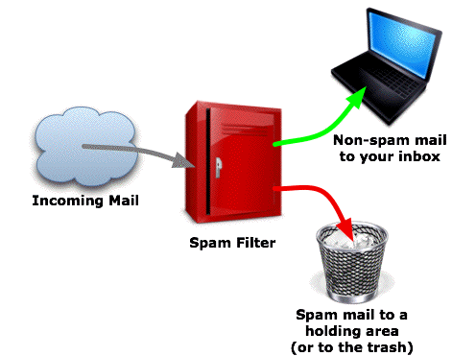
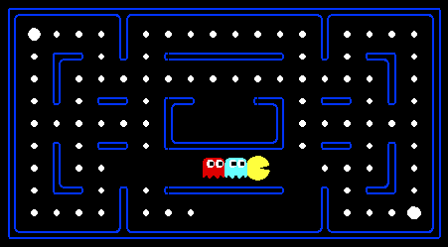
Episodic vs. sequential
Episodic: Agent receives a single percept per episode. Its action in this episode does not affect future percepts (e.g. classification)
Sequential: Agent receives a sequence of percepts. The current action affects future percepts. (e.g. navigation, game playing)
vs.

Slide 31
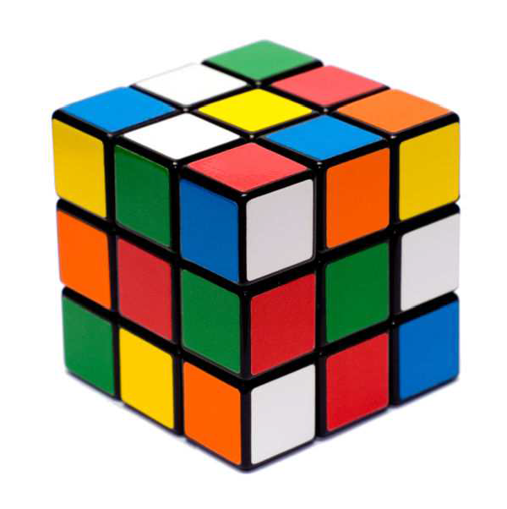

Static vs. dynamic
Is the world changing while the agent is thinking?
Static: Environment doesnʼt change unless agent performs an action. (e.g. crossword puzzles)
Dynamic: Environment changes even when the agent doesnʼt do anything. (e.g. traffic)
Semi-dynamic: The environment is static, but the agentʼs performance score changes over time. (e.g. chess against a clock)
vs.

Slide 32
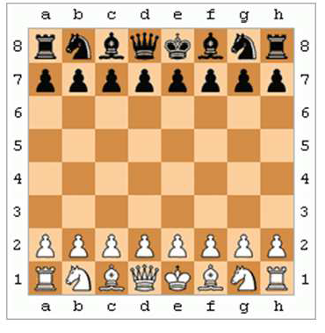
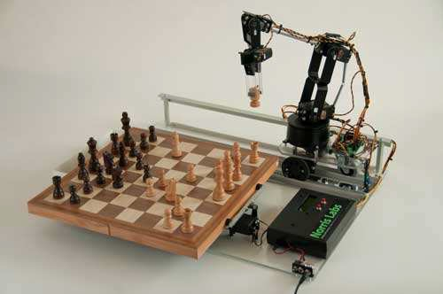
Discrete vs. continuous
Continuous: Time, percepts and actions are continuous.
Example: driving a car.
Discrete: Time, percepts and actions are discrete.
Example: playing a board game.
vs.

Slide 33

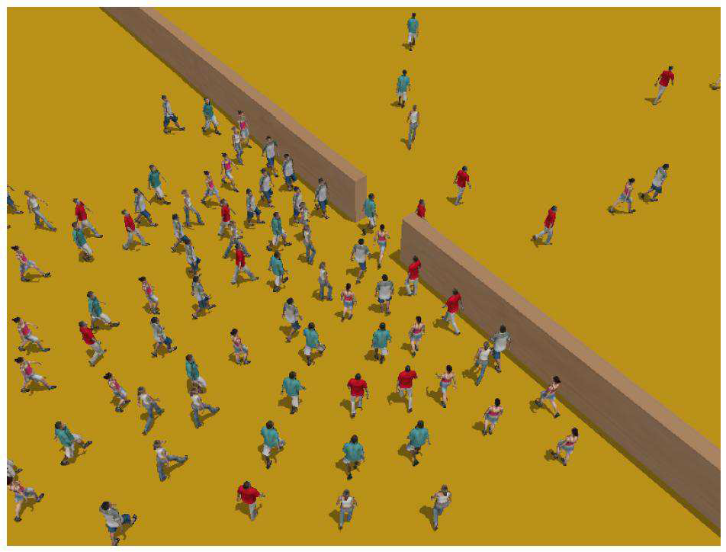
Single-agent vs. multiagent
Is an agent operating by itself in the environment?
vs.

Slide 34
Summary
Observable
Deterministic Episodic
Deterministic Sequential
Static
Discrete
Agents
Cross Word
Fully
Static
Discrete
Single
Poker
Fully
Stochastic
Sequential
Static
Discrete
Multi
Backgammon
Partially
Stochastic
Sequential
Static
Discrete
Multi
Taxi driver
Partially
Stochastic
Sequential
Dynamic
Conti
Multi
Part picking robot Partially
Stochastic
Episodic
Dynamic
Conti
Single
Image analysis
Fully
Deterministic
Episodic
Semi
Conti
Single

Slide 35
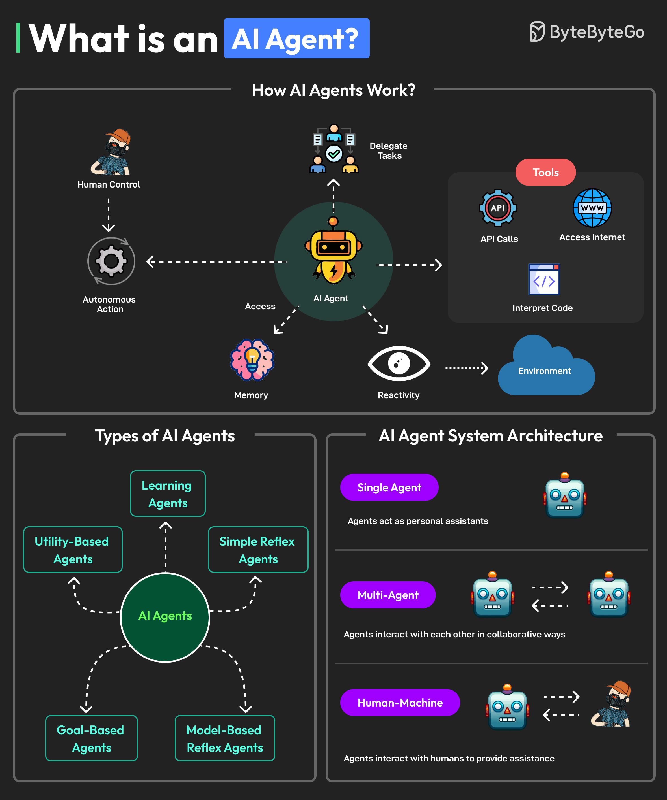

Slide 36
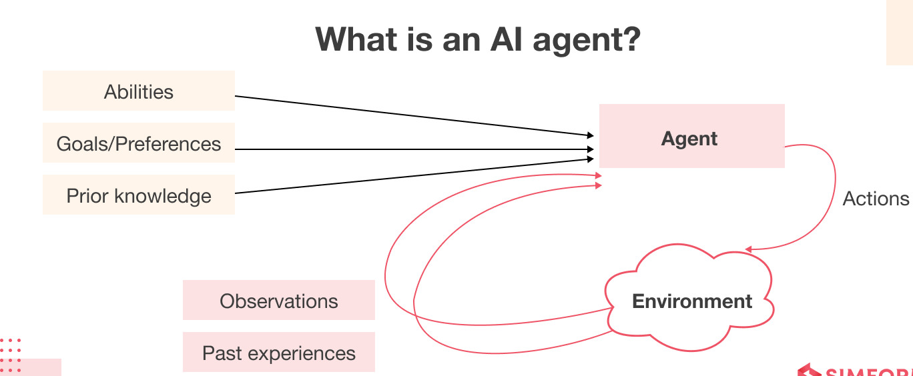
Notes:
AI agents are autonomous software programs that perceive their environment through sensors and act on it using actuators. They operate independently without human intervention and execute tasks by leveraging advanced technologies such as machine learning, Natural Language Processing (NLP), large language models (LLMs), or Foundation Models (FMs).
AI agents excel at solving complex problems by decomposing queries, planning task sequences, and employing a reasoning process akin to human thought. They can handle ambiguous questions and utilize various tools, such as APIs, programs, and web searches, to execute tasks and find solutions effectively.

Slide 37
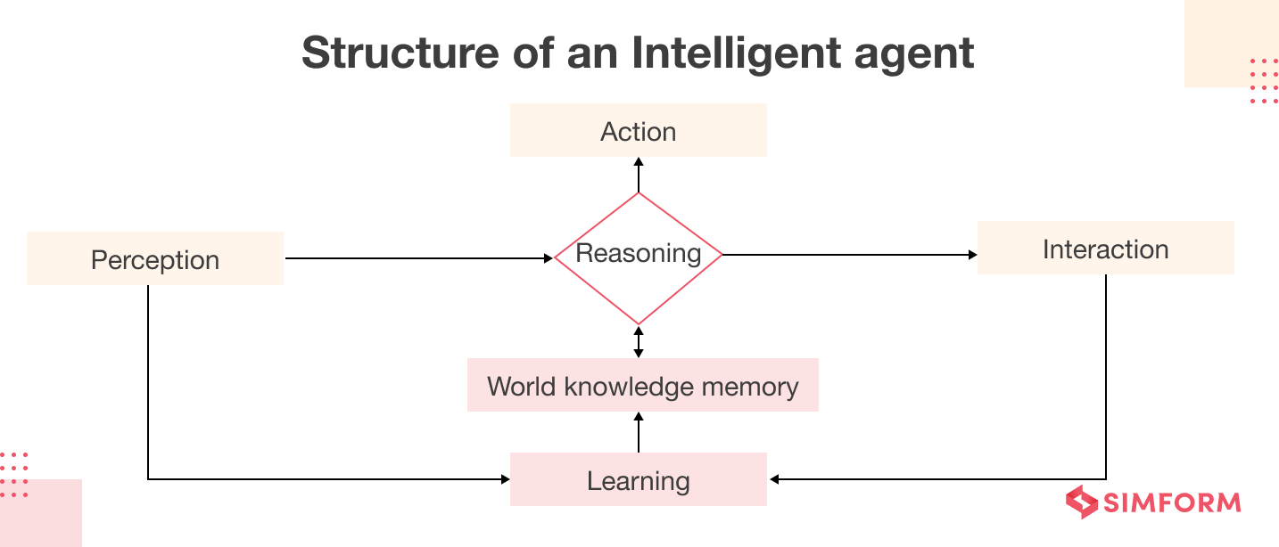
How Do AI Agents Work?
AI is a rational agent, and a human can also be a rational agent, as can an enterprise, a machine, or software. An AI agent considers past and present relevant factors to arrive at an optimal, desirable outcome.

Slide 38
How Do AI Agents Work?
Sensor: An electronic device that picks up on environmental changes and sends that information to other electronic devices. Through sensors, an agent can observe its surroundings.
Actuators: Parts of machines that turn energy into action. Actuators are limited to the movement and control of the AI system. Electric motors, gears, rails, and other mechanisms can all function as actuators.
Effectors: Devices that have an impact on the environment. Effectors include legs, wheels, arms, fingers, fins, wings, and display screens.

Slide 39
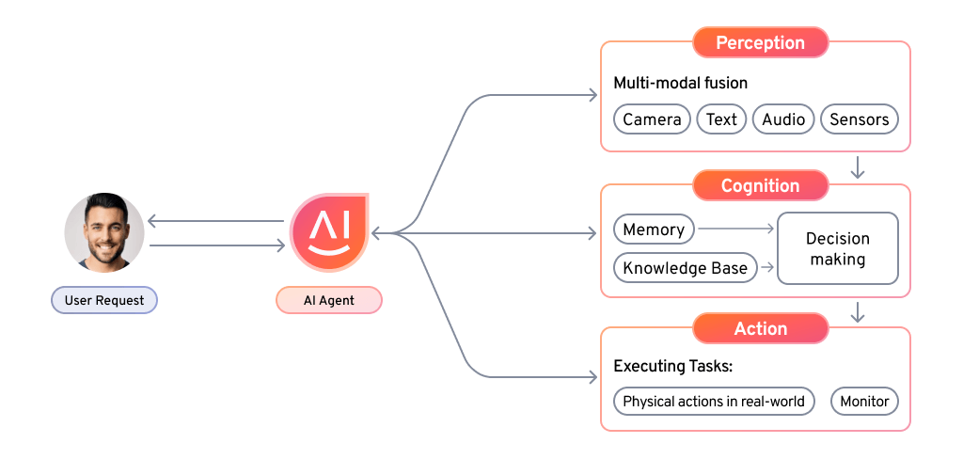
AI Agent Architecture?
Notes:
Architectural Components of AI Agents
Agentic systems have several interconnected components that work together to enable intelligent behavior. Each element plays a crucial role in the overall functioning of the AI system, and they must interact seamlessly to achieve desired outcomes. Let’s explore each of these components in more detail.
Perception Module
Sensory input gathers data, feature extraction processes it, and object recognition identifies key elements using AI techniques.
Cognitive Module
Goal representation defines objectives, planning maps out strategies, and decision-making selects the best action to achieve results.
Action Module
Actuators enable actions, while execution carries them out to interact with the environment.
Learning Module
Reinforcement learning learns through rewards, supervised learning from labeled data, and unsupervised learning finds patterns in unlabeled data.

Slide 40
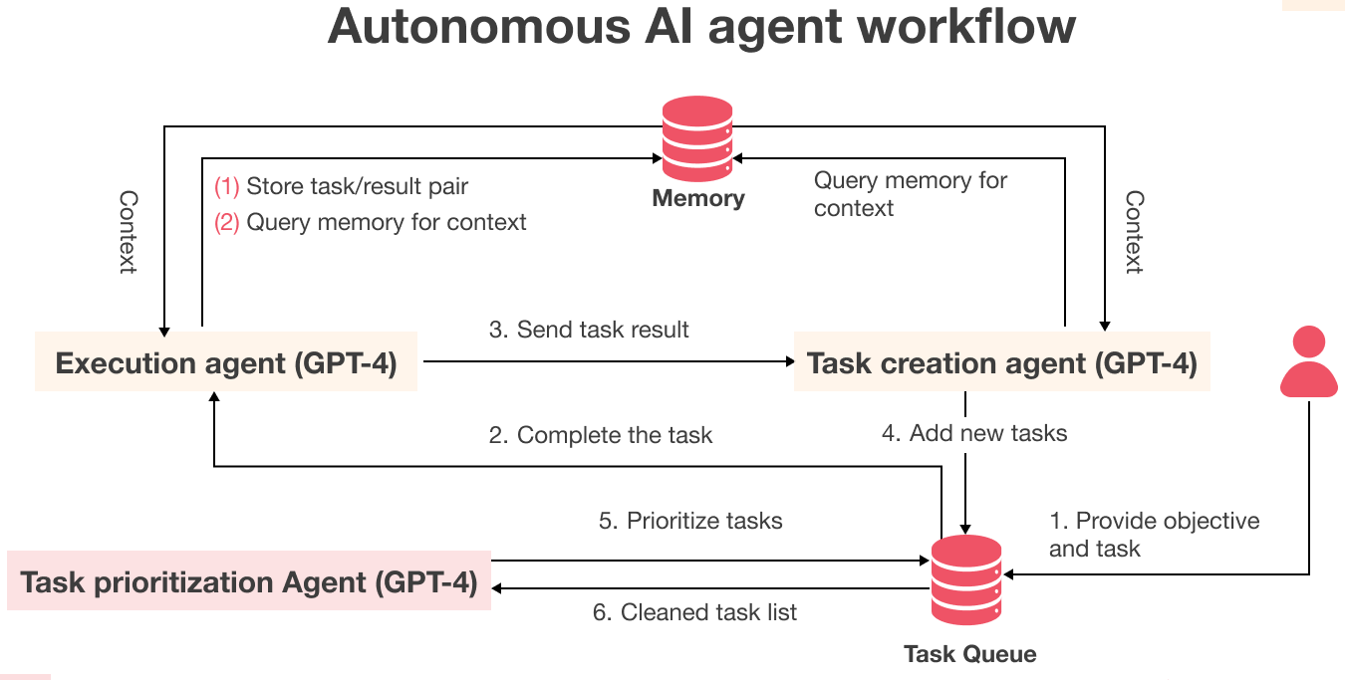
Notes:
Architectural Components of AI Agents
Agentic systems have several interconnected components that work together to enable intelligent behavior. Each element plays a crucial role in the overall functioning of the AI system, and they must interact seamlessly to achieve desired outcomes. Let’s explore each of these components in more detail.
Perception Module
Sensory input gathers data, feature extraction processes it, and object recognition identifies key elements using AI techniques.
Cognitive Module
Goal representation defines objectives, planning maps out strategies, and decision-making selects the best action to achieve results.
Action Module
Actuators enable actions, while execution carries them out to interact with the environment.
Learning Module
Reinforcement learning learns through rewards, supervised learning from labeled data, and unsupervised learning finds patterns in unlabeled data.

Slide 41
Agent Types
Basic types in order of increasing generality:
Simple reflex agents
Reflex agents with state/model
Goal-based agents
Utility-based agents
Learning based Agents
Multi Agent

Slide 42
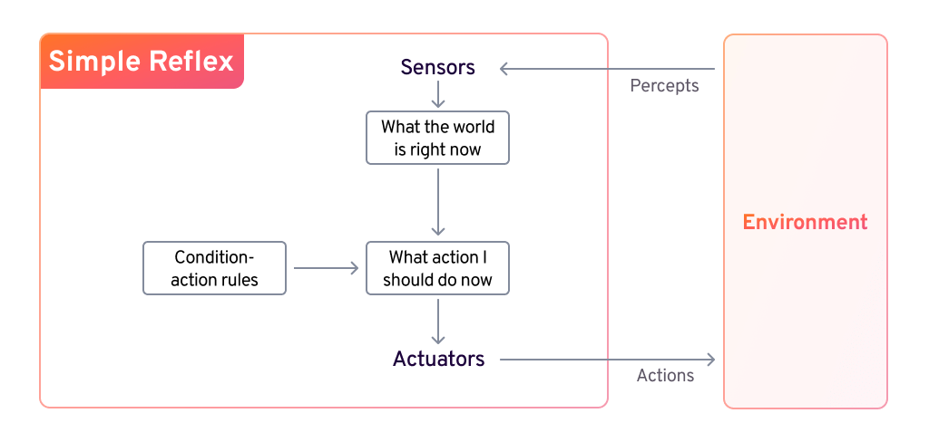
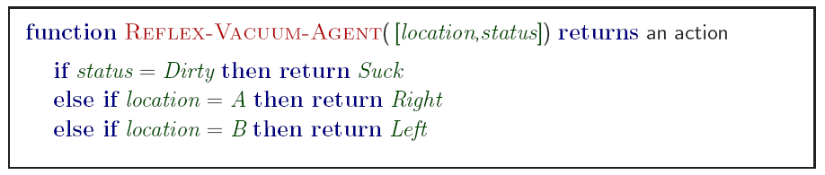
Simple Reflex Agents
Notes:
Simple Reflex Agent
A simple reflex agent reacts to its current environment using predefined condition-action rules, without memory or learning. It works best in fully observable environments but struggles in complex or dynamic ones. Lacking adaptability, it cannot handle unstructured scenarios and requires manual rule updates for changes. While useful for basic tasks, it falls short in situations requiring reasoning or long-term learning.

Slide 43
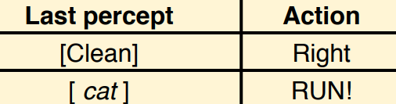
Simple Reflex Agents
Simple but very limited intelligence.
Action does not depend on percept history, only on current percept.
Therefore, no memory requirements.
hard to verify success for complex tasks
good for simple agents (bar code scanners, e.g.)

Slide 44
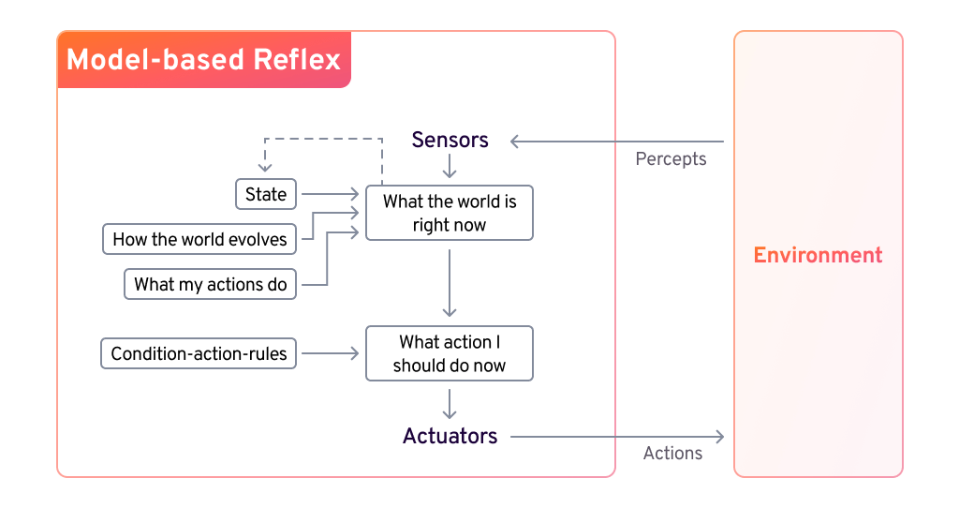
Model-based reflex agents
Notes:
Model-Based Reflex Agents
Model-based agents use an internal world model to infer missing information and handle partially observable environments. They update their state based on percept history, tracking changes in the world and how their actions impact it.

Slide 45
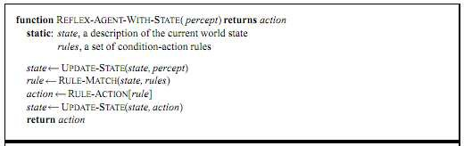
Model-based reflex agents
Know how world evolves
0 Overtaking car gets closer from behind
How agents actions affect the world
0 Wheel turned clockwise takes you right
• Model base agents update their state

Slide 46
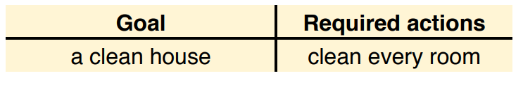
Goal-based agents
knowing state and environment? Enough?
Taxi can go left, right, straight
Have a goal
A destination to get to
Uses knowledge about a goal to guide its actions
E.g., Search, planning

Slide 47
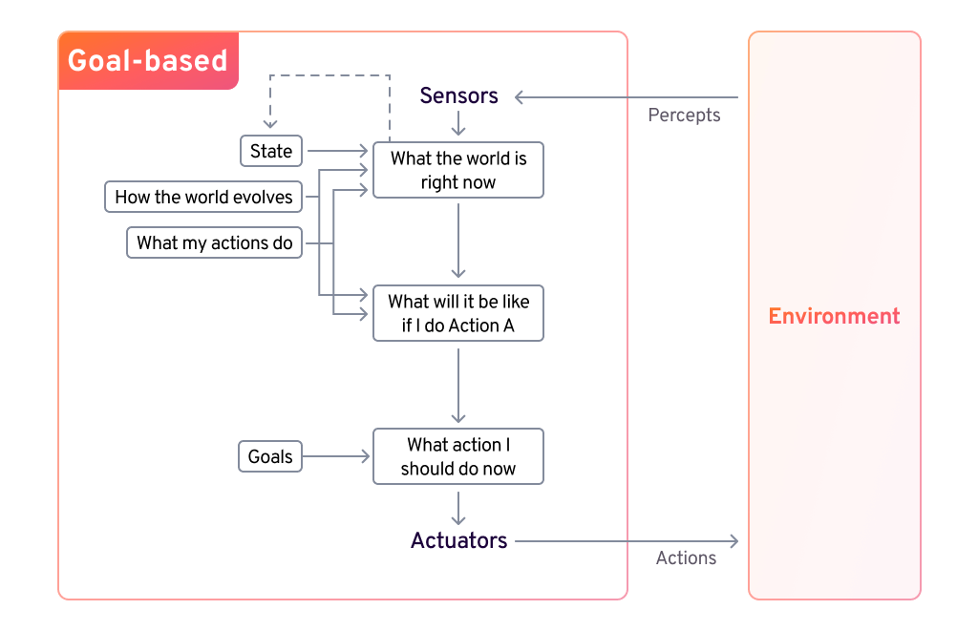
Goal-based agents
Reflex agent breaks when it sees brake lights. Goal based agent reasons
– Brake light -> car in front is stopping -> I should stop -> I should use brake
Notes:
Goal-Based Agents
Goal-based agents make decisions by considering future outcomes and selecting actions that bring them closer to their objective. They use search, planning, and adaptable decision-making, allowing for flexibility in complex tasks like navigation and gameplay.

Slide 48
Utility-based agents
Goals are not always enough
Many action sequences get taxi to destination
Consider other things. How fast, how safe…..
Agent can choose between multiple actions to achieve its goal. Which is best?
Agent may have conflicting goals. Which one to pursue first?
Agents may have a utility function, which (ideally) approximates the external performance measure.
Economics: money.
Biology: number of offspring.
Your life?

Slide 49
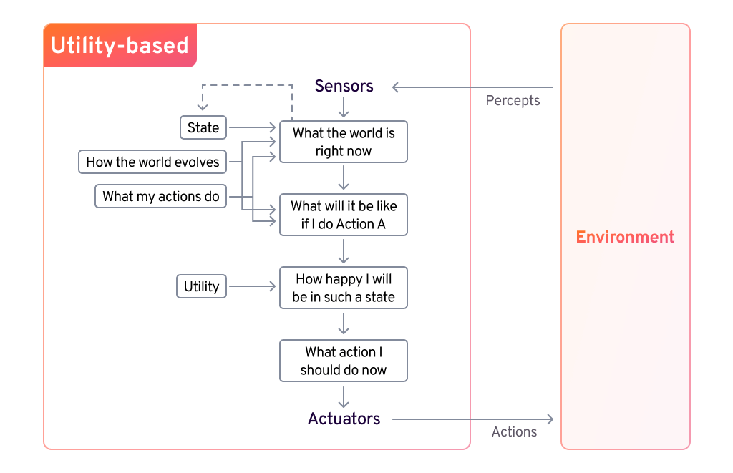
Utility-based agents
Notes:
Utility-Based Agents
Utility-based agents optimize decision-making by evaluating actions using a utility function to maximize performance. They consider factors like cost, speed, and safety, selecting the most beneficial path in complex or uncertain environments.

Slide 50
Learning agents(Taxi driver)
Performance element
How it currently drives
Taxi driver Makes quick left turn across 3 lanes
Critics observe shocking language by passenger and other drivers and informs bad action
Learning element tries to modify performance elements for future
Problem generator suggests experiment out something called Brakes on different Road conditions
Exploration vs. Exploitation
Learning experience can be costly in the short run
shocking language from other drivers
Less tip
Fewer passengers
40

Slide 51
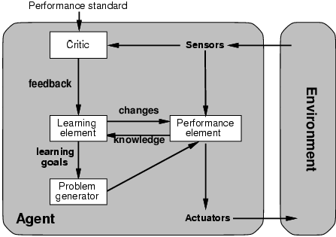
Learning agents
Performance element is what was previously the whole agent
Input sensor
Output action
Learning element
Modifies performance element.

Slide 52
Learning agents
Notes:
Autonomous Learning Agents
Learning agents adapt and improve through experience, optimizing strategies over time. They consist of a learning element (adapts to data), a critic (provides feedback), a performance element (selects actions), and a problem generator (explores new possibilities), making them ideal for dynamic environments.

Slide 53
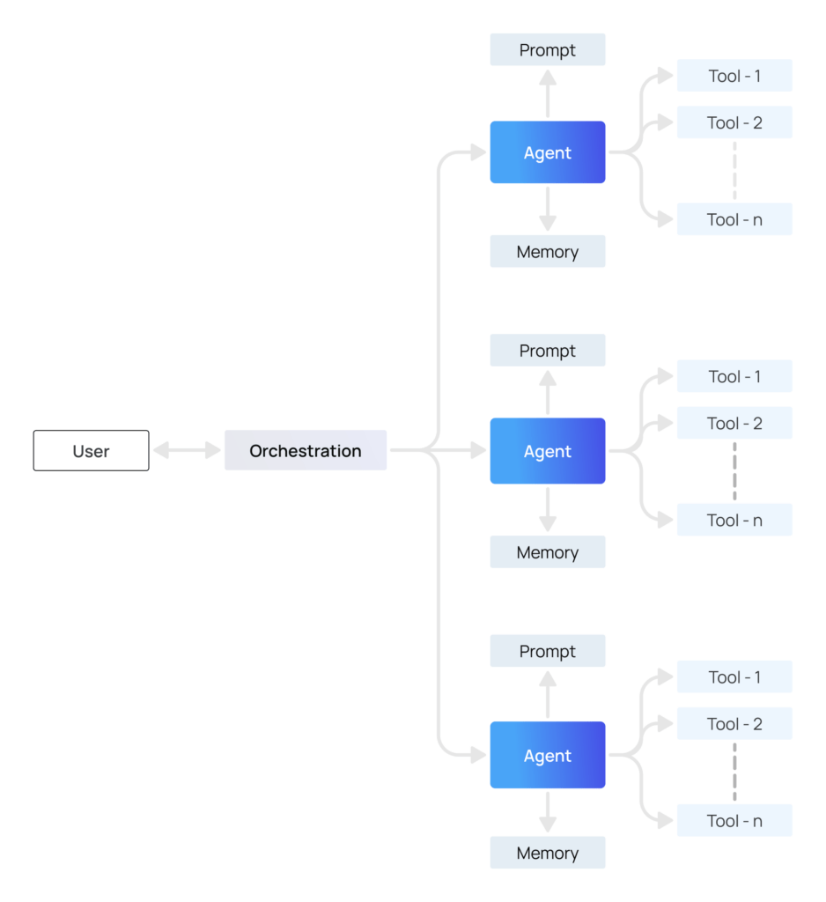
Multi Agent Systemm
Notes:
What are Multi-Agent Systems?
Multi-agent systems (MAS) are frameworks where multiple independent agents, each capable of making decisions, work together to achieve complex goals. These agents can collaborate, coordinate or even compete depending on the system’s objectives.
Multi-agent architecture structures these systems by having multiple agents work together under the supervision of an agentic orchestration to scale and make decisions as the system gets more complex.
Artificial intelligence (AI) is no longer just a tool. It’s becoming an intelligent workforce of AI agents that can plan, reason, and execute tasks. The rise of multi-agent systems is changing enterprise operations by allowing specialized agents to work together, tackle complex workflows across IT, HR, customer service, and more.
This shift from single-task automation to coordinated decision-making AI agents is not just a trend, it’s a business imperative. The terms Agentic AI and AI Agents are everywhere, it’s moving from theory to reality. AI advancements are moving multi-agent systems from research to real-world applications, making it more relevant to solve real-world problems.
For C-level executives, this is more than just an innovation – it’s a boardroom requirement. Companies that don’t adopt Agentic AI will fall behind as competitors use it to transform customer and employee experiences, reduce costs, and increase productivity. The future of enterprise AI isn’t on the horizon – it’s here now.
At the core:
Agents are entities, often powered by large language models (LLMs), designed to do specific tasks.
Multi-agent systems have multiple agents communicating and working together to solve complex problems more efficiently than a single-agent system.
Multiple Agents in Autonomous Systems
Multi-agent systems are changing the game for businesses by making automation more adaptive, resilient, and scalable. Instead of having one AI model process vast amounts of data and make decisions, MAS distributes tasks across multiple agents, each capable of handling different functions.
This means more efficiency, better problem solving, and more complex applications from intelligent process automation to autonomous agents.
What is Multi-Agent AI, and Why Does It Matter?
Multi-agent systems (MAS) are frameworks where multiple independent agents, each capable of autonomous decision-making, work together to achieve complex goals. These agents can collaborate, coordinate, or even compete depending on the system’s objectives. At their core:
Agents are entities, often powered by large language models (LLMs), designed to perform specific tasks.
Multi-agent systems involve multiple agents communicating and collaborating on tasks to solve complex problems more efficiently than a single-agent system.
The Significance of Multi-Agent AI in Autonomous Systems
Multi-agent systems are revolutionizing enterprises by enabling more adaptive, resilient, and scalable automation. Instead of relying on a single AI model to process vast amounts of data and make decisions, MAS distributes tasks across multiple specialized agents, each capable of handling distinct functions.
This shift enhances efficiency, improves problem-solving capabilities, and enables more sophisticated applications, from intelligent process automation to autonomous robotics.
Fundamentals of Agent Systems
A multi-agent system consists of multiple intelligent agents that can sense, learn, and act autonomously to achieve individual and collective goals. These systems are powered by artificial intelligence and have key benefits like flexibility, scalability, and robustness.
Key Components of Multi-Agent Systems
Multi-agent systems are a network of intelligent agents communicating, collaborating, and autonomously executing tasks. Building multi-agent systems is complex and requires careful planning and execution. Let’s take a look at the main components in this system. These systems leverage AI and advanced large language models to understand context, generate insights, and automate complex tasks.
Agentic AI: How AI agents autonomously interact and learn
Agentic AI refers to agent-based systems that are powered by AI and operate autonomously, make decisions, learn from interactions, and adapt to changing business environments. Unlike traditional AI models that rely on pre-programmed rules, agentic AI evolves in real-time through data and reinforcement learning.
Features:
Autonomous decision making – AI agents analyze data and execute tasks with minimal human intervention.
Self learning – AI agents refine processes by learning from past decisions and environmental changes.
Inter-agent collaboration – AI agents talk to each other to divide tasks, share knowledge, and optimize outcomes.
Agentic Orchestration: Coordinating multiple AI copilots for decision-making
As you deploy multiple AI agents, the challenge shifts from individual agent or a monolithic system automation to multi-agent decision making. Agentic orchestration ensures that multiple AI agents:
Don’t conflict with each other.
Follow the goals while adapting to real-time changes.
Optimize business outcomes through collective intelligence.
Connecting agents within a multi-agent system is key. Effective communication and interaction between the agents improve performance and coordination.
Key Business Benefits:
Cross-functional automation – AI copilots synchronize across IT, HR, finance, and customer support.
Real-time adaptability – AI adjusts strategies based on changing business conditions.
Seamless enterprise wide AI integration – AI copilots share knowledge across departments to improve AI workflows and unified intelligence.
AI Reasoning: Enhancing problem-solving and adaptability
For AI to be autonomous, it has to process data and reason, and strategize. AI reasoning enables multi-agent systems to:
Analyze complex business scenarios and propose solutions.
Simulate multiple outcomes to minimize risk and maximize efficiency.
Adapt workflows dynamically to changing customer and market demands.
Multi Agents vs Single Agent Systems
As enterprises scale agentic AI, the question arises: Do we use a single agent or multi-agent systems? While single-agent AI has its place, multi-agent enterprise AI systems are more adaptable, intelligent, and efficient, so a game changer for businesses that want to automate at scale.

Slide 54
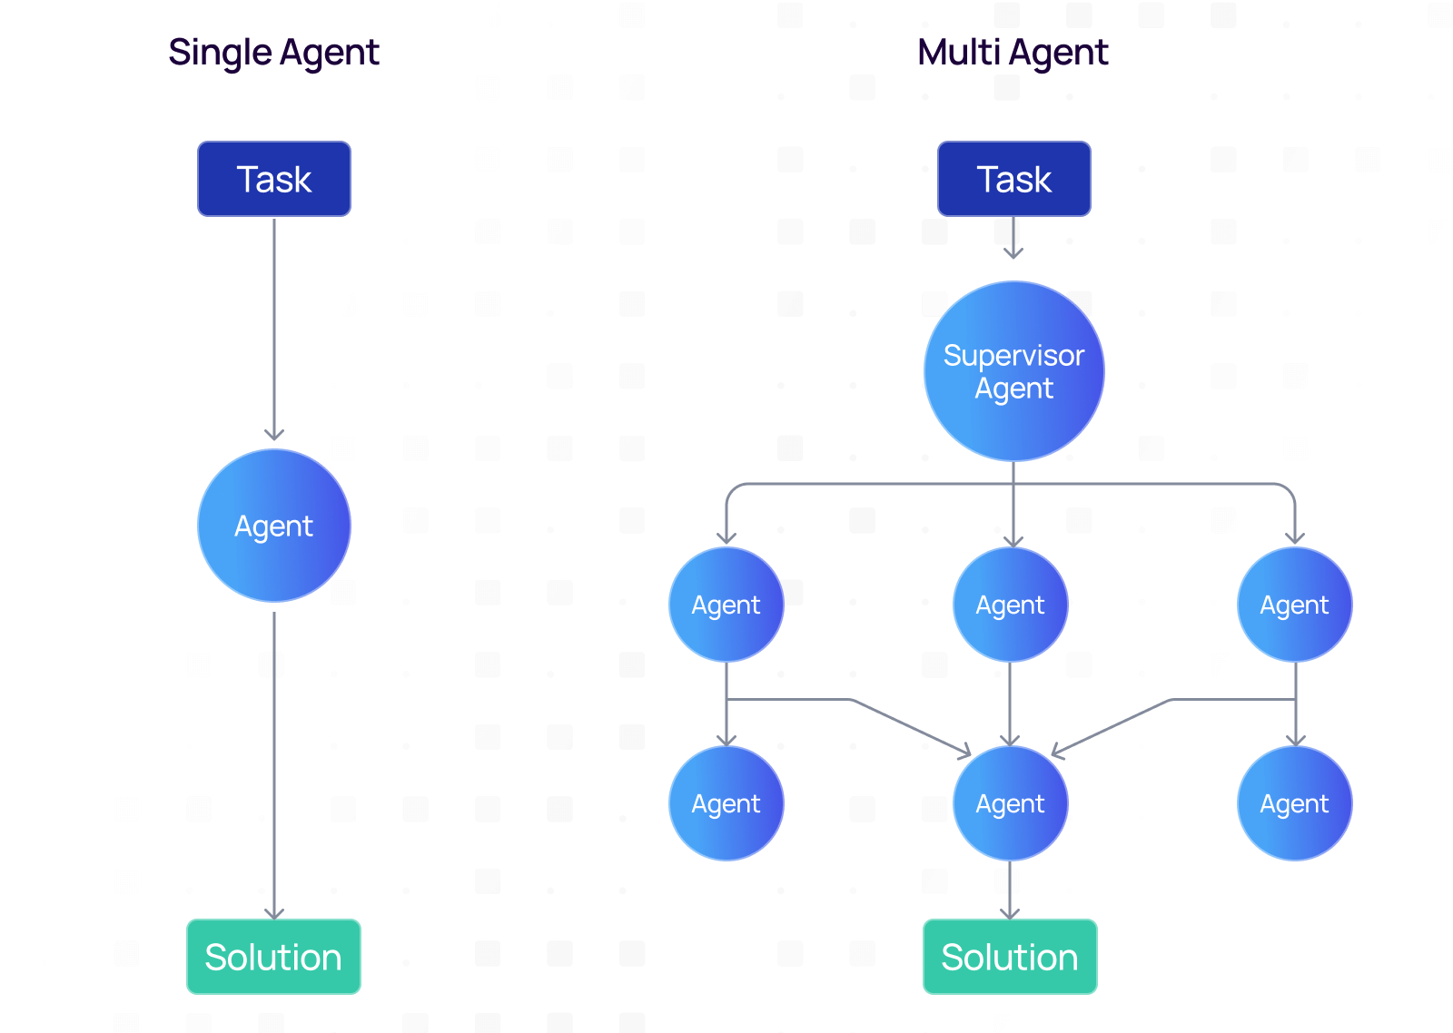
Notes:
Multi Agents vs Single Agent Systems
As enterprises scale agentic AI, the question arises: Do we use a single agent or multi-agent systems? While single-agent AI has its place, multi-agent enterprise AI systems are more adaptable, intelligent, and efficient, so a game changer for businesses that want to automate at scale.
Differences between Single-agent vs. Multi-agent AI
FactorsSingle-agent AI systemMulti-agent AIDecision-makingCentralized, slower responsesDistributed, faster insightsScalabilityLimited to specific tasks; single AI agents struggle with complexityExpands across business functionsAdaptabilityPre-trained, fixed rulesLearns and improves dynamicallyResilienceHigh risk of failureFault-tolerant and robustEnterprise applicationsSuited for simple automationIdeal for complex workflows and AI-driven decision-making
Why multi-agent AI outperforms single AI models
Traditional AI deployments often rely on single-agent AI models, which operate independently to complete tasks. These models are effective but have limitations:
Scalability Issues – A single AI model struggles to handle complex, multi-faceted enterprise operations.
Limited Specialization – A one-size-fits-all model lacks deep domain expertise.
Bottlenecks in Decision-Making – Without distributed intelligence, a single AI model can become a point of failure.
The Multi-Agent Advantage
Multi-agent systems have multiple intelligent agents, each specialized for specific functions, working together seamlessly to enhance the effectiveness and clarity of the overall solution.
Distributed Intelligence – AI agents collaborate to divide complex tasks, ensuring faster and more accurate execution.
Scalability & Adaptability – Enterprises can add AI agents on-demand to meet evolving business needs.
Autonomous Decision-Making – AI copilots coordinate without human intervention, increasing efficiency.
Example: A single-agent AI model in customer service may only handle FAQs, while a multi-agent system can:
Identify customer sentiment (NLP agent)
Retrieve relevant policies (Knowledge AI agent)
Recommend actions to support teams (Automation agent)
By working together, multi-agent systems accelerate issue resolution, enhance customer experience, and reduce operational costs.
Use of domain-specific LLMs in distributed AI systems
To maximize the effectiveness of multi-agent AI, domain-specific LLMs (Large Language Models) play a critical role. Unlike generalized AI models, domain-specific LLMs are fine-tuned for industry-specific tasks, ensuring accuracy, compliance, and efficiency.
How Domain-Specific LLMs Improve Multi-Agent AI
Context-Aware AI Agents – LLMs enable AI agents to interpret industry jargon, regulations, and AI workflows.
Higher Precision & Compliance – AI-driven automation aligns with HIPAA (healthcare), SOX (finance), or GDPR (data privacy).
Industry-Specific Decision-Making – AI agents leverage LLMs to provide relevant, real-time insights.
Impact of machine learning on autonomous multi-agent interactions
Multi-agent systems continuously leverage machine learning (ML) to improve collaboration, efficiency, and accuracy. Multiple interacting intelligent agents enable the system to become more adaptive and intelligent over time.
Key AI Advancements in Multi-Agent Learning
Reinforcement Learning – AI agents learn from feedback loops, optimizing decisions over time.
Self-Improving AI agents – Continuous learning allows AI agents to adapt to new enterprise challenges.
Predictive AI Coordination – AI agents anticipate business needs, automate workflows, and enhance decision-making.
Example: In supply chain management, multi-agent AI uses ML-driven predictive analytics to anticipate demand fluctuations, optimize logistics, and prevent disruptions.

Slide 55
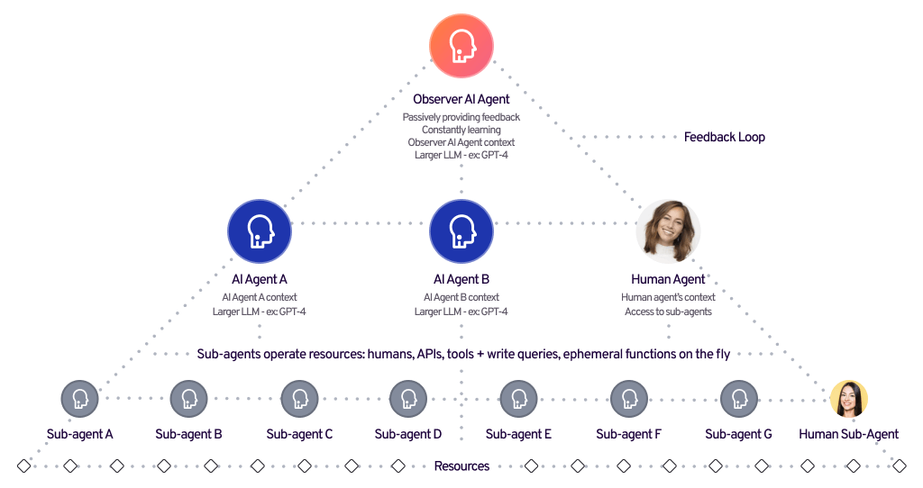
Hierarchical Agent
Notes:
Hierarchical Agents
Hierarchical agents operate in multi-layered structures where high-level agents set goals and low-level agents execute tasks. This approach enhances efficiency in complex systems by breaking down tasks and ensuring organized decision-making.

Slide 56
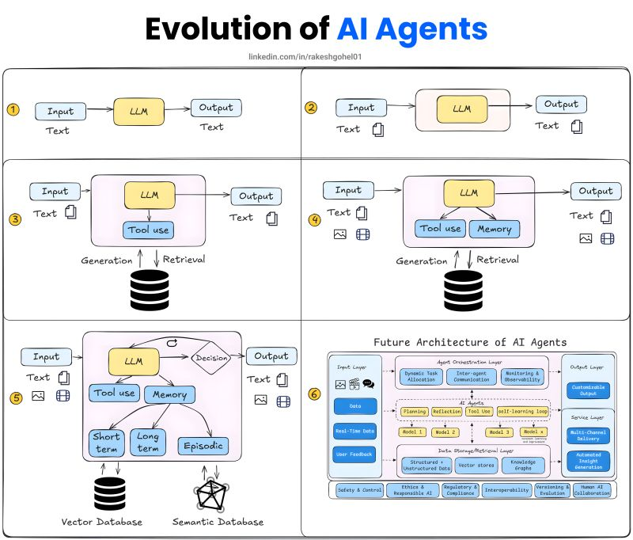
Notes:
The best way to learn about AI Agents is to understand their evolution, here's how to approach it better... From the rise of Generative AI technology like LLMs, There's been a desire for a well-equipped autonomous system that could use a wide range of tools yet be very conversational. They could utilize the very foundation of GenAI and include other cognitive features like Memory, So, after several iterations, we finally came down to Agents but it was not a straightforward change, 📌 here are a few iterations made along the way to where we are as an Agentic system: 1. The Very Beginning - A Large Language Model - Workflow: Input: Text → LLM → Output: Text - These are the transformer-based architectures that were trained on a large variation of datasets to create intelligent chatbots. - This laid the very foundation of AI Agent's future. 2. LLM with larger context Inputs and Outputs: - Workflow: Input: Text/Document → LLM → Output: Text/Document - With LLMs became smarter so they needed to process information beyond the 8k context window. - The new LLM architecture was updated with a larger context window to parse bigger documents. 3. RAGs and Tool use - Workflow Input: Text/Document corpus → LLM + Tool use + RAGs → Output: Text/Document - Access to the latest information soon became the new trend in GenAI. Hence, RAGs were introduced. - Similar to RAGs, to improve LLMs responses we started seeing more tool integrations like search API to improve results. 4. Introduction to Multi-Modal workflow - Workflow: Multi-Modal Input → LLM + Tool use + RAGs → Multi-modal Output - This laid the very foundation of a simple agentic architecture. - With the support of real-time data retrieval features, these agents can already perform complex tasks with decent human intervention. 4. Our current AI Agent architecture - Workflow: Text + Multi-Modal Data Input → LLM + Tool Use + Memory → Decision → Text + Multi-Modal Data Output - AI agents are now equipped with advanced structures: a. Memory types: Short-term, Long-term and Episodic to remember past activities for improvements. b. Tool Calling: Utilizing third-party APIs for performing a wide range of tasks like search, flight booking, etc. c. Decision: Rather than just failing to act, it uses ReACT to start the process again with a different approach to get an output. d. Supporting better Knowledge bases: Current agents now utilise even semantic databases to form better connections across different nodes for improved reasoning. 5. Future architecture of AI Agents - Learn more about them here: https://lnkd.in/gvzUsaag What are your views on the future of AI Agents?

Slide 57
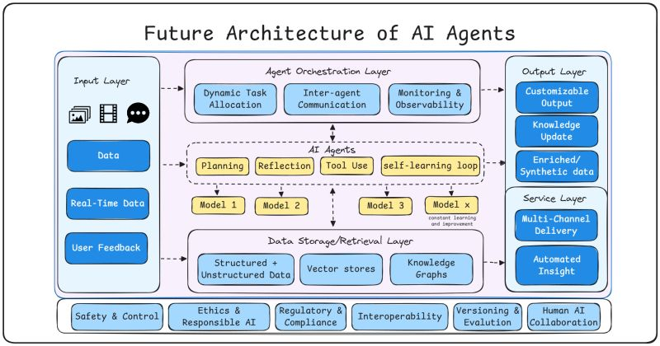
Notes:
The next generation of AI Agents is not just smarter They will be fundamentally different, Let me explain... Sam Altman in a recent Reddit AMA emphasized the popularity of AI Agents. (Learn more here: https://lnkd.in/gzTFADZM) These AI Agents can clearly accelerate the development of different fields. However, it is certain that their architecture will greatly differ from our current architecture. Though we cannot exactly predict the future architecture. Here is my take on a possible architectural change within AI agents: 1️⃣ Input Layer Sophistication: - Multimodal data processing (images, video, text) - Real-time data integration capabilities - Dynamic user feedback loops - Adaptive data handling mechanisms 2️⃣ Agent Orchestration Excellence: - Dynamic task allocation for optimal resource usage - Sophisticated inter-agent communication protocols - Advanced monitoring and observability features - Real-time performance optimization 3️⃣ AI Agents Core Capabilities: - Strategic planning and decision-making - Self-reflection and improvement mechanisms - Intelligent tool selection and utilization - Continuous learning loops for perpetual enhancement - Multiple specialized models working in harmony (Model 1 .. Model X) 4️⃣ Data Architecture Innovation: - Unified storage for structured and unstructured data - Advanced vector stores for efficient retrieval - Knowledge graphs for complex relationship mapping - Scalable and adaptable data management 5️⃣ Output Layer Sophistication: - Customizable output formats - Multi-channel delivery systems - Automated insight generation - Adaptive response mechanisms 📌 What truly sets this architecture apart is its focus on: 1. Safety & Control: Ensuring reliable and secure operations 2. Ethics & Responsible AI: Building trust through ethical principles 3. Regulatory Compliance: Futureproofing against evolving regulations 4. Interoperability: Seamless integration capabilities 5. Versioning & Evolution: Systematic improvement tracking 6. Human-AI Collaboration: Maintaining human-centric development Which update are you most excited about?

Slide 58
The End
41

